Slide 1
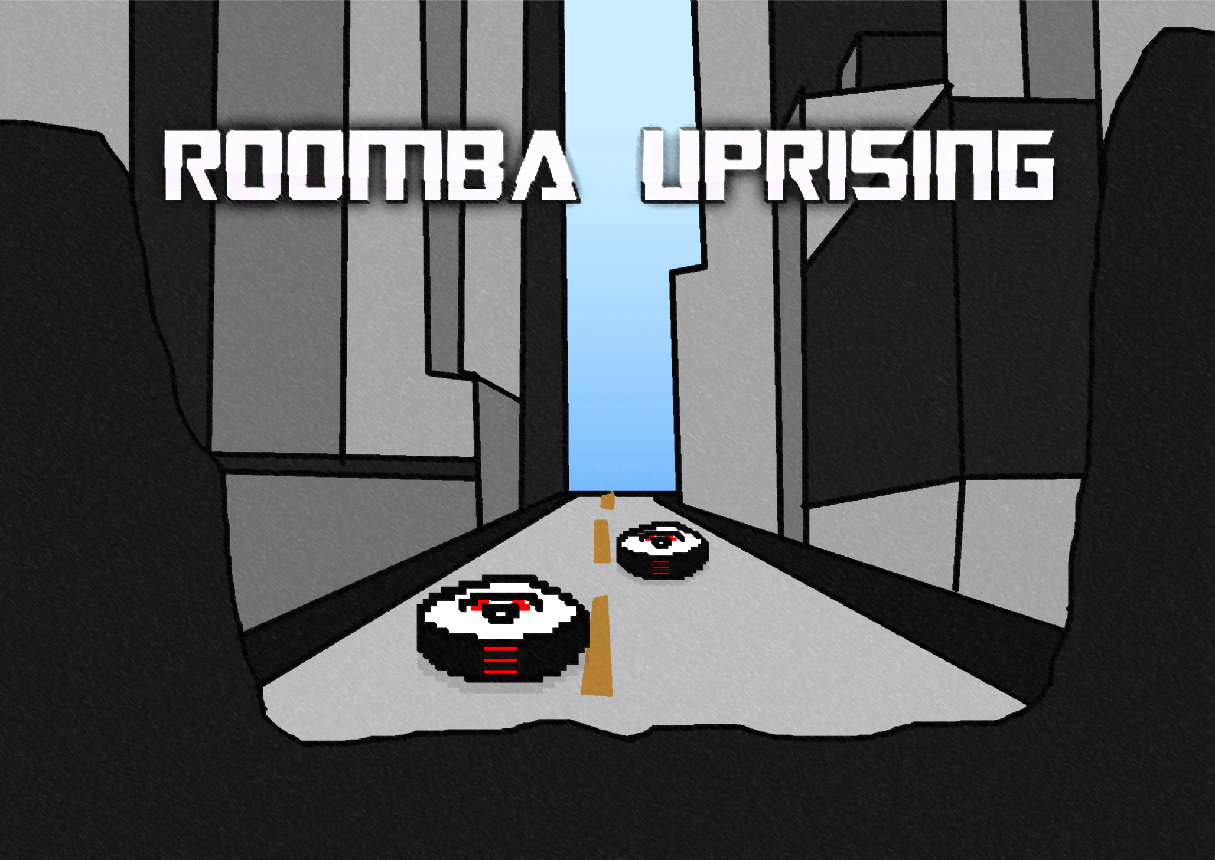
Save the world by making a mess!

Slide 2



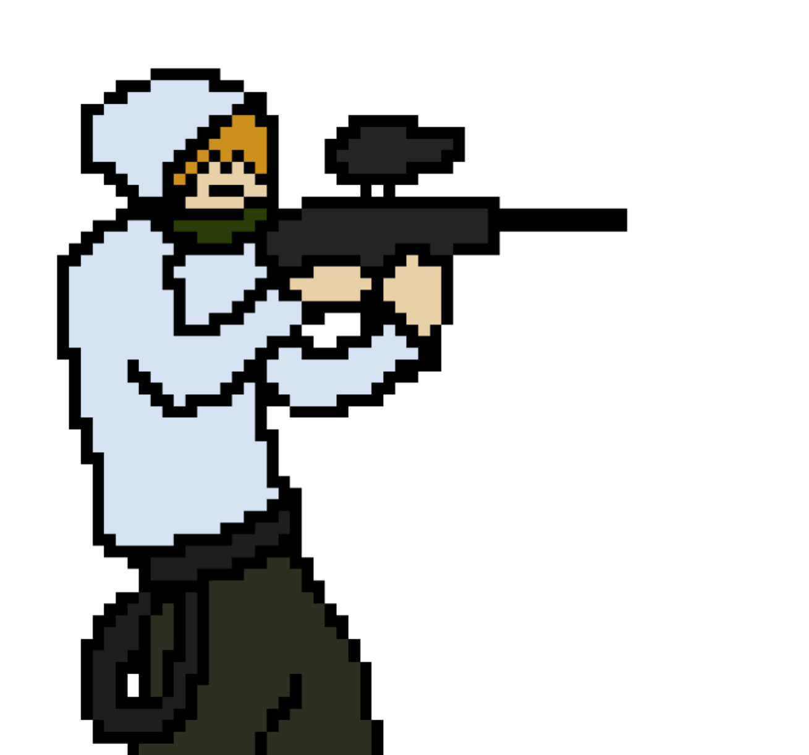


High concept
Roomba uprising is a stealth shooter with puzzle elements with an extensive amount of roombas. Exciting stealth gameplay and tactical paintball action. Set in the near future, roombas have taken over the world. With the assistance from a one-legged scientist the player must overthrow the roomba overlords.
Notes:
The paintball enthusiastic player must stop the roombas
Use your paintball gun and paint grenades to stun
Use rubbish to distract Roombas
Receive assistance from a scientist
Save the world by making a mess

Slide 3
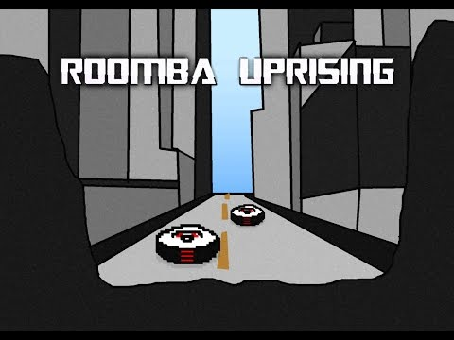
Core mechanics
Stealth
Distract with rubbish
Paintball gun
Paint grenade
Roomba detection

Slide 4

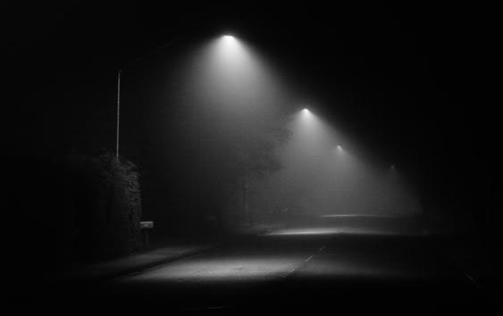
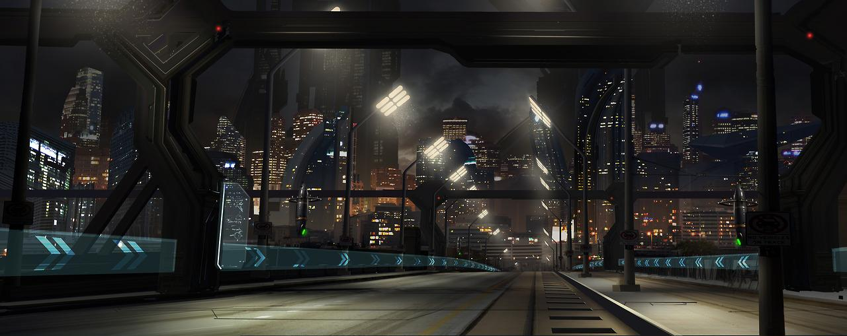
Aesthetic
Pixel art
8bit vibes/music
Dark with illuminated roombas
Flickering street lights
Dark and gritty
Cyberpunk

Slide 5

Similar games
Ninja Stealth £4
Hotline Miami £7
Dynamite Jack £7
Monaco £11
Mark of the ninja £11

Slide 6
Target audience
Fans of the stealth survival experience
Connoisseurs of retro games
Indie game consumers
15 - 22 due to dark gritty themes
Roomba enthusiasts

Slide 7




Unique selling points
Comical stealth experience
Spotlessly clean apocalyptic environment
Anti-recycling campaign
10,000 + “spooky” Roomba overlords
Make a mess to save the world

Slide 8

Technical & production feasibility
Final product to be developed in gamemaker 7
Similar style games have been created on this engine
Pixel art style doesn't require much artistic ability
After the mechanics have been created making the levels will be quick
Optimisation of Roombas so many can be displayed on screen at once

Slide 9

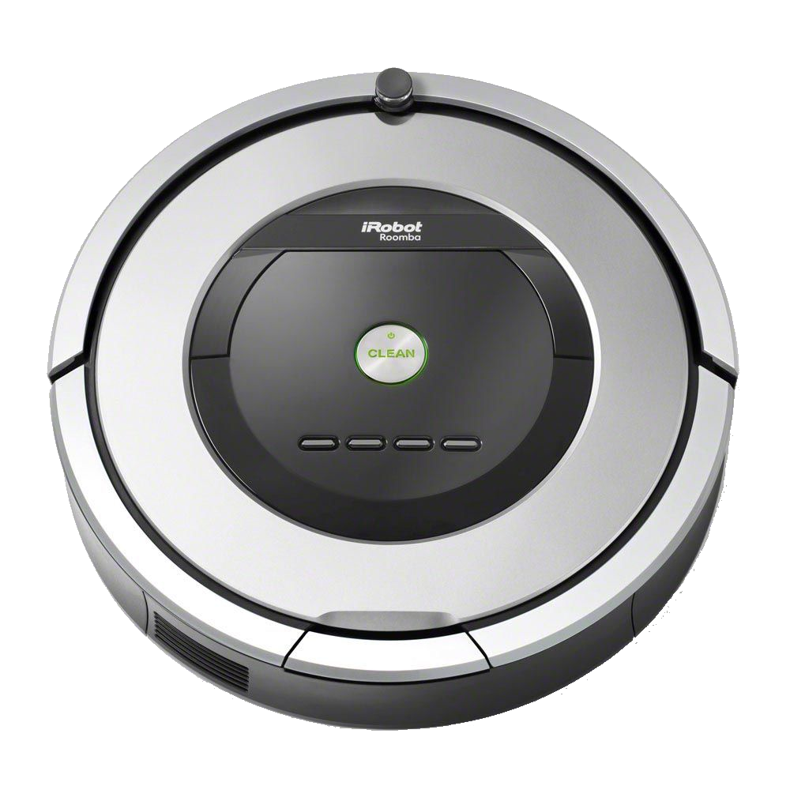
Commercial feasibility
Total Cost
£20,000
This includes:
Wages, Software, Hardware, Licences and
Rent
Product will be free under promotional advertising and a possible sponsorship deal with iRobot Roomba.
The projected downloads of the game are 5000 copies in the first month of release.

Slide 10
LIVE DEMO
RAWR XD
Notes:
RAWR XD

Slide 11
Questions

